Slide 1
UCAELI Conversation Partner Orientation Video
A crash course in how to be a great Conversation Partner!
University of Connecticut American English Language Institute (UCAELI)

Slide 2
Part One: Welcome to UCAELI!

Slide 3
General Information about UCAELI
UCAELI students are international students enrolled in the full-time English language program at UConn
Students’ proficiency levels: beginner to advanced.
Instructors will inform Conversation Partners about their students’ level.

Slide 4
What is Conversation Class?
The activities during conversation time are linked to UCAELI Communication Skills course objectives.
There is usually an activity, discussion topic or question for each class.

Slide 5
Instructors are a resource for you!
The instructors:
facilitate the activity
circulate the classroom listening and joining into conversation when they see fit
should be consulted when there is any question about the conversation partner’s role or activity objective
should be approached when a conversation partner is uncomfortable with a question or topic
are open to conversation partner feedback

Slide 6
Conversation Partner Tip for the first class:
Have an open mind
Be aware of the level of English proficiency of the students in the class
Take a look at EAQUALs Descriptors for Listening and Spoken Interaction to have a better understanding of what students need to be able to do at each level (link is on the Conversation Partners section of the UCAELI website or can Google search “EAQUALs bank of descriptors”)
Be ready to share, listen, learn, collaborate and converse!

Slide 7
Part Two: Be open to and respect other cultures!

Slide 8
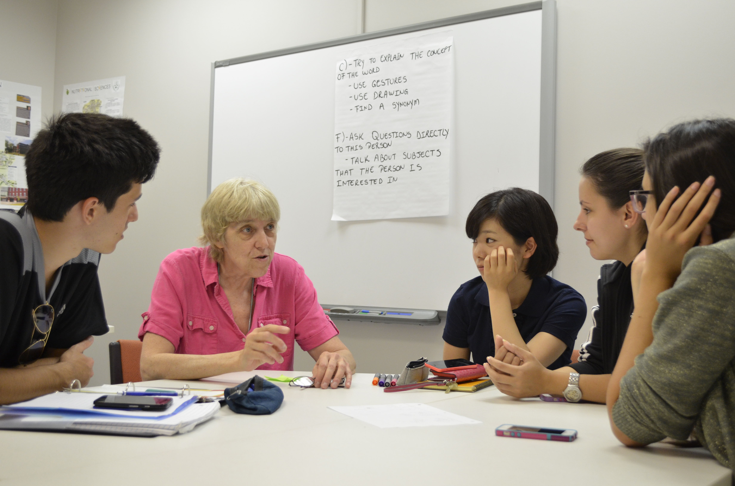
Our goal is to create a comfortable learning environment for all of our students.

Slide 9
Note: Some students will…
Not have a lot of experience conversing with people of the opposite gender
Be uncomfortable discussing certain topics
Remember: patience, sensitivity and respect is key

Slide 10
Be careful not to criticize a student’s culture or religion

Slide 11
Conversation Partner Tip: Ask about the student’s home country, family and traditions!
Questions about these topics allow students to share their own culture
Contribute when you see fit
Find commonalities through these topics to make connections!

Slide 12
Part Three:
Understanding each other’s speech

Slide 13
You will probably need to speak more slowly and clearly than usual, especially with lower-level students. Take your time and make sure the student understands.

Slide 14
If a student does not understand what you said, try to restate it in a different, simpler way.

Slide 15
Commonly, students will smile and nod their head appearing to understand what you are saying while they really have no idea.

Slide 16
Conversation Partner Tip: Promote Active Listening to combat the “Head Nodding Effect”
Pause often and elicit a verbal response
Check in for understanding
Don’t ask: “Do you understand?”
Ask a question related to what you are saying
For example:
You’re chatting about your pet at home and instead of asking if they understood that you were talking about your beloved cat, ask them if they have any pets of their own!
Avoid “yes” / “no” questions!

Slide 17
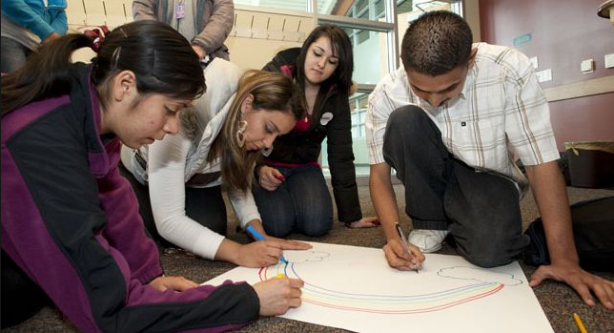
Conversation Partner Tip: Drawing pictures helps low level beginners.

Slide 18
Sometimes student’s do not understand “American Slang”
Try to limit the use of words or phrases like:
“epic fail”
“that’s cray”
“hanging out”
“dude”
“It was a blast”
“awesome”
“just chillin’”
“That was sick”
“bro”
“He is ripped!”

Slide 19
Conversation Partner Tip: If you use “American Slang,” explain it!
“awesome” = great, really good, etc.

Slide 20
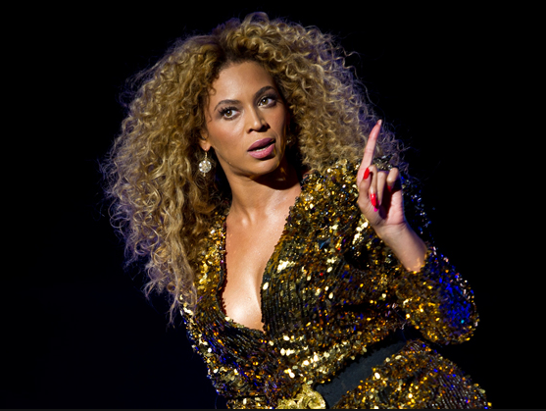
Be aware of potential cultural blind spots
Explain it. They probably want to know!
Make sure the students know what you’re talking about.
Believe it or not, not everyone knows about Beyonce

Slide 21
Conversation Partner Tip: Encourage student speaking
Try not to go on long rants or stories without checking in
Do not be the only participant in the conversation – share air time!
Students should talk AT LEAST as much as you do, if not MORE ☺

Slide 22
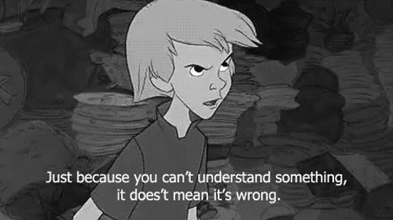
Don’t be afraid to tell students that you don’t understand what they are saying!
Just kindly ask them to repeat it or use different words to explain!

Slide 23
You can correct a student’s pronunciation.
Do it nicely and make sure you let them know once they say it correctly!

Slide 24
In sum, when you’re in a low-level class:
Talk slower than you normally would
Ask questions to check for understanding
Draw!
Don’t be afraid to help with pronunciation
Use simple vocabulary
Avoid culturally-bound language: idioms or references to specific to American life
For example: government policies, tax systems, etc

Slide 25
Part Four: Group Work

Slide 26
Conversation Class Objectives
One of the priorities of the Conversation Partner Program is to enhance topics and skills from their UCAELI class
Incorporate these topics and skills into conversation if you can
If you are unsure of the current focus of the class, feel free to ask the instructor

Slide 27
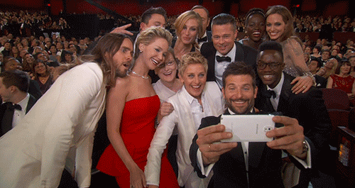
Try to make sure everyone in your group contributes to conversation.

Slide 28
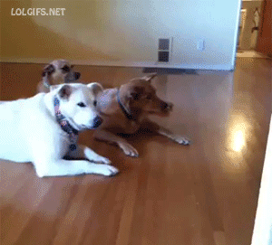
Sometimes outgoing students will dominate the conversation.

Slide 29
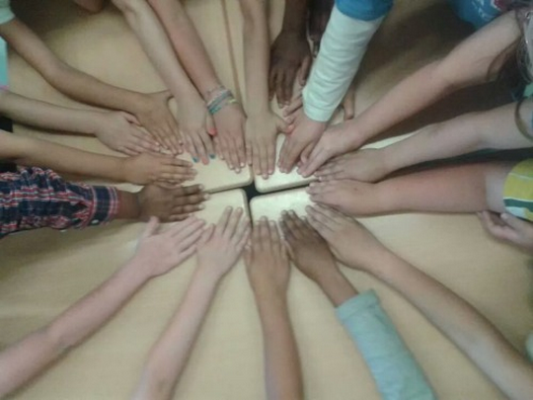
Try to make an effort to draw out quiet, shy or lower-level students.

Slide 30
Also, make sure you’re not the one talking too much!
Ask questions!
Facilitate the conversation, but don’t overpower it!

Slide 31
Part Five: The students appreciate you!

Slide 32
Our students consistently report the positive impact of the Conversation Partner interaction
They learn a lot from conversing with you each week!

Slide 33
Conversation Partner Tip: Have fun!!
Celebrate cross-cultural experience with UCAELI!

